Slide 1
Job-shop Scheduling
MD. AHSAN HABIB

Slide 2
Job Shop
  A work location in which a number of general-purpose workstations exist and are used to perform a variety of jobs.
  Example:
    Car repair – each operator (mechanic) evaluates plus schedules, gets material, etc.
    Traditional machine shop, with similar machine types located together, batch or individual production

Slide 3
Scheduling
  Scheduling is the action of assigning resources to perform tasks.
  The resources may be processors, network links, or expansion cards.
  The tasks may be threads, processes or data flows.
  The scheduling activity is carried out by a process called the scheduler.

Slide 4
Job Scheduling
  Job scheduling is a process that allocates system resources to control the execution of unattended background programs.
  An optimization problem and aka batch scheduling.
  The scheduler decides which jobs to execute, at which time, and the central processing unit (CPU) resources needed to complete the job.
  You will know details about it in Operating System course

Slide 5
Job-shop Scheduling (JSS)
  Variant of job scheduling.
  Each job consists of a set of operations O1, O2, ..., On which need to be processed in a specific order.
  Each operation has a specific machine that it needs to be processed on.
  Only one operation in a job can be processed at a given time.
  Aka the job-shop problem (JSP) or job-shop scheduling problem (JSSP).

Slide 6
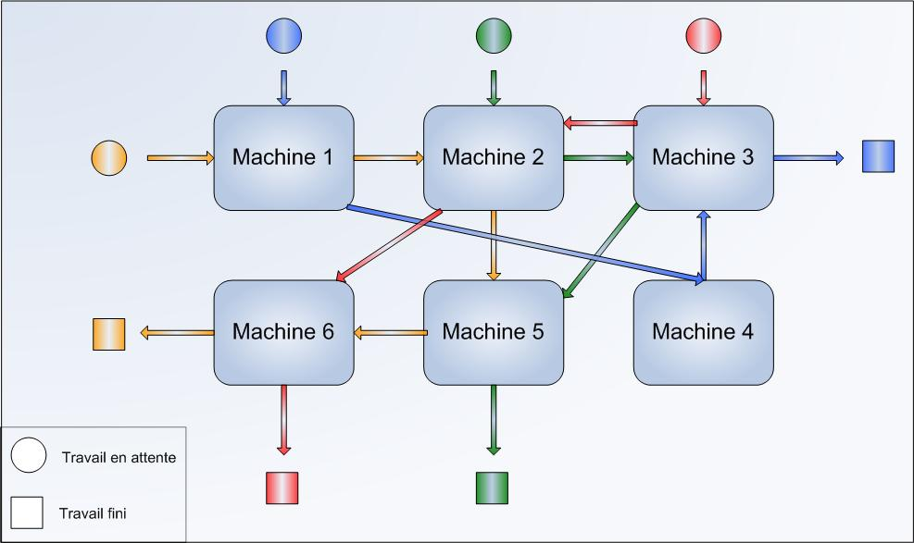
JSS
  n jobs (J1, J2, … , Jn)
  m machines (M1, M2, … , Mn)

Slide 7
JSS contd…
  3 jobs (J1, J2, J3)
  3 machines (M1, M2, M3)
  Assumption: at time = 0, all jobs are available.
        J1 = { M1(7), M3(8), M2(10) }
        J2 = { M2(6), M1(4), M3(12) }
        J3 = { M1(8), M3(8), M2(7) }

Slide 8
JSS contd…
        J1 = { M1(7), M3(8), M2(10) }
        J2 = { M2(6), M1(4), M3(12) }
        J3 = { M1(8), M3(8), M2(7) }
        J1 M1(7) M3(8) M2(10)
        J2 M2(6) M1(4) M3(12)
        J3 M1(8) M3(8) M2(7)

Slide 9
JSS contd…
        At t=0,
        J1 and J3 in M1
        J2 in M2
        M2 starts processing J2 (only one). Then at t=6, J2 is finished at M2 and goes for execution at M1.
M1
6 (J2)
J2
M2
6
M3

Slide 10
JSS contd…
        At t=0,
        J1 and J3 in M1
        M1 starts processing J1 as it has less execution time than J3.
        Rule 1: Choose the job with the smallest processing time (SPT).
        Rule 2: Don’t keep a machine idle when the job is waiting.
J1
M1
6 (J2) 7
J2
M2
6
M3
7 (J1)

Slide 11
JSS contd…
        At t=7,
        J2 and J3 are available at M1.
        J1 at M3.
        M1 starts processing J2 (SPT) and finished at t=11.
        M3 starts processing J1 and finished at t=15.
J1
J2
M1
6 (J2) 7
11
J2
M2
6
15 (J1)
J1
M3
7 (J1)
15
11 (J2)

Slide 12
JSS contd…
J1
J2
J3
M1
        At t=11,
        J3 is available at M1.
        J1 at M3.
        M1 starts processing J3 and finished at t=19.
6 (J2) 7
11
19
J2
M2
6
15 (J1)
19 (J3)
J1
M3
7 (J1)
15
11 (J2)

Slide 13
JSS contd…
        At t=15,
        J1 at M2.
        J2 at M3.
        M2 starts processing J1 and finishes at t=25.
        M3 starts processing J2 and finishes at t=27.
        Completed job:
        J1 = 25
        J2 = 27
J1
J2
J3
M1
6 (J2) 7
11
19
J2
J1
M2
6
15 (J1)
19 (J3)
25
J1
J2
M3
7 (J1)
15
27
11 (J2)

Slide 14
JSS contd…
        At t=25,
        J3 at M2.
        M2 starts processing J3 and finishes at t=33.
        Completed job:
        J1 = 25
        J2 = 27
J1
J2
J3
M1
6 (J2) 7
11
19
J2
J1
J3
M2
6
15 (J1)
19 (J3)
25
33
J1
J2
M3
7 (J1)
15
27
33 (J3)
11 (J2)

Slide 15
JSS contd…
        At t=33,
        J3 at M3.
        M3 starts processing J3 and finishes at t=40.
        Completed job:
        J1 = 25
        J2 = 27
        J3 = 40
J1
J2
J3
M1
6 (J2) 7
11
19
J2
J1
J3
M2
6
15 (J1)
19 (J3)
25
33
J1
J2
J3
M3
7 (J1)
15
27
33 (J3)
40
11 (J2)

Slide 16
JSS contd…
J1
J2
J3
M1
6 (J2) 7
11
19
J2
J1
J3
M2
6
15 (J1)
19 (J3)
25
33
J1
J2
J3
M3
7 (J1)
11 (J2)
15
27
33 (J3)
40
        Gantt Chart

Slide 17
JSS contd…
        Makespan = 40
        Total completion time = 25 + 27 + 40
J1
J2
J3
M1
6 (J2) 7
11
19
J2
J1
J3
M2
Job | CT | DD
J1 | 25 | 25
J2 | 27 | 30
J3 | 40 | 35
6
15 (J1)
19 (J3)
25
33
J1
J2
J3
M3
7 (J1)
15
27
33 (J3)
40
11 (J2)

Slide 18
JSS contd…
Job | CT | DD
J1 | 25 | 30
J2 | 27 | 25
J3 | 40 | 35
J1
J2
J3
M1
6 (J2) 7
11
19
J2
J1
J3
M2
        Total tardiness = 7
        Tardiness job = 2
        Max tardiness job = J3
        Max tardiness = 5
6
15 (J1)
19 (J3)
25
33
J1
J2
J3
M3
7 (J1)
15
27
33 (J3)
40
11 (J2)

Slide 19
JSS contd…
J1
J2
J3
        Utilization:
        M1= 19/40
        M2 = 24/40
        M3 = 27/40
M1
6 (J2) 7
11
19
J2
J1
J3
M2
6
15 (J1)
19 (J3)
25
33
J1
J2
J3
M3
7 (J1)
15
27
33 (J3)
40
11 (J2)

Slide 20
Dispatching rule
A dispatching rule is a rule that prioritizes all the jobs that are awaiting for processing on a machine.
Whenever a machine has been freed, a dispatching rule inspects the waiting jobs and selects the job with the highest priority.

Slide 21
Types of Dispatching rule
Processing time based
Number of operations
Due date based
Others

Slide 22
Types of Dispatching rule
Processing time based
  Shortest Processing Time
  Longest Processing Time
  Shortest Total Processing Time
  Longest Total Processing Time
  Shortest Remaining Processing Time
  Longest Remaining Processing Time

Slide 23
Types of Dispatching rule
Number of operation based
  Min # operation
  Max # operation
  Min Remaining # operation
  Max Remaining # operation

Slide 24
Types of Dispatching rule
Due date based
  Earliest Due Date
  Least Slack
  Min Slack / Remaining # operation
  Slack = Due Data – Current Time – RPT

Slide 25
Types of Dispatching rule
Others
  FCFS/FIFO
  LIFO
  Random

Slide 26
References
https://www.youtube.com/watch?v=xZs7WsNPJXY&ab_channel=nptelhrd

